Slide 1
Simulation and Analysis of Inter-satellite Communication for Real-Time Data Downloading
Student Name: Tsang Chun Hei
Student ID: 21032048d
Supervisor: Dr. LYU Mingsong

Slide 2
1. Problem
The limitation of traditional Satellite data transmit

Slide 3
4,700
Active Low Earth Orbit (LEO) Satellites till to 1 May 2022

Slide 4
Low Earth Orbit (LEO) Satellites
Below 2000 kilometers above the earth
Lower signal propagation delay in LEO
Efficiency communicate with Earth-based stations
Capture more detailed pictures

Slide 5
LEO Satellite used to
Communications
Observe Ground
Military Reconnaissance
Navigation
…

Slide 6
However….
LEO Satellite Coverage issues
Limited Ground Station
May not be able to transmit data to the ground immediately
May need to wait until reach the communication scope of Ground Station

Slide 7
Experiment result
Transmit to the Ground Station
Nearby ➔ More than 10 seconds
opposite on earth ➔ Around 3050 seconds
Far away to the orbit ➔ more than 3050 seconds
It is not able to meet the real-time system constraints

Slide 8
2. Solution
How to solve the limitation

Slide 9
To Solve the Problem
Inter-satellite communication
Transfer data from Satellite to Satellite
Reach the Satellite in the target communication scope
Finally transfer to the target Ground Station

Slide 10
Difficulty
LEO Satellite and Ground Station positions are not constant
Calculate the Earth-centered inertial(ECI) position with the time dimension
How to decide which satellite transfer to
Design and use Path Decision Algorithm

Slide 11
3. Simulator
A simulator to proof and implement the solution

Slide 12
Objective
Given a Set of LEO Satellite, a target Ground Station, and an Observation Point
Simulate the behavior of
LEO Satellite and Ground Station position change
the Communication
Calculate the data transmit path and delay

Slide 13
Introduction
Use Earth-Centered Inertial (ECI)
3-dimensional Cartesian coordinate system
Original fixed center in the Earth's mass center
Fixed with respect to the stars
Position on Earth is always changed by the Earth’s rotation

Slide 14
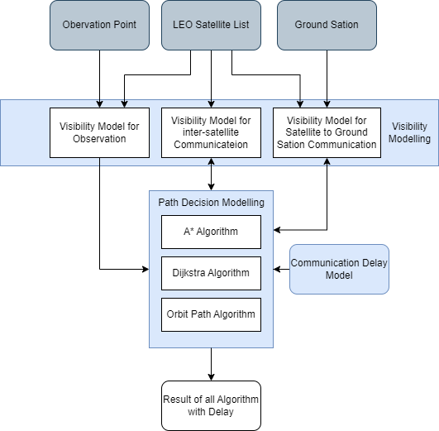
Components Flowchart
Visibility Model
Path Decision Model
Communication Delay Model

Slide 15
Path decision Algoirthm
A*
Dijkstra
Orbit Base

Slide 16
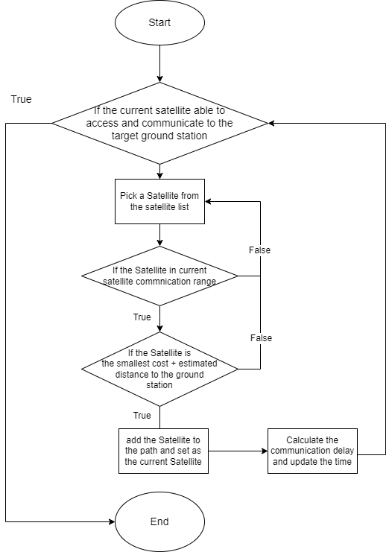
A*
Update the time after decided the next node
Less iteration
Great performance

Slide 17
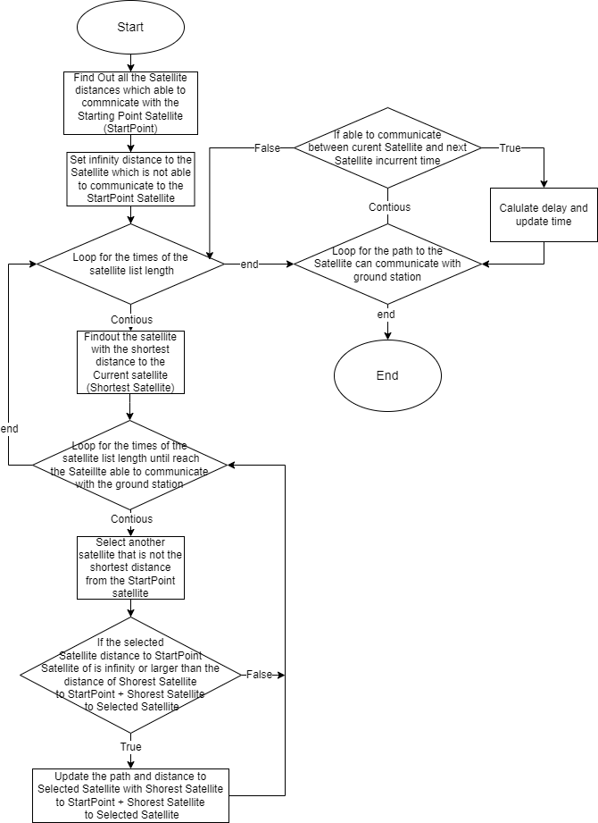
Dijkstra
Update the time after decided the whole path
Most iteration
Best performance

Slide 18
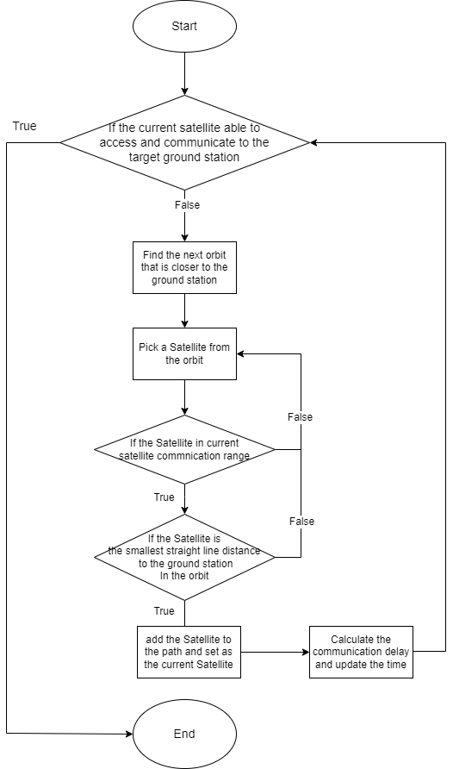
Orbit Base
Update the time after decided the next node
Less iteration
Normal performance

Slide 19
Parameter of the Simulator
Inclination
Define the inclination angle of the LEO Orbit.
Default Value: 97 degree
Argument of Perigee
Define the inclination angle of the LEO Orbit.
Default Value: 0 degree
Motion
Define the orbit revolution around earth per day.
Default Value: 14
Orbit Size
Define the numbers of orbit.
Default Value: 9
Satellite Size
Define the numbers of Satellite for each orbit.
Default Value: 25
Off Nadir
Define the off-nadir angle of LEO Satellite to observation.
Default Value: 45 degree

Slide 20
Parameter of the Simulator
Buffer Delay
Define the buffer delay from network congestion to each Satellite. Default Value: 0.05 seconds
Process Delay
Define the process delay from processing data on Satellite.
Default Value: 0.01 seconds
Package Size
Define the package size of data to transmit.
Default Value: 56623104 Bytes (54MB)
Data Rate
Define the data rate of the Satellite signal for data transmit.
Default Value: 530579456 Bytes/s (506MB/s)
Signal Speed
Define the signal speed of the Satellite to transmit data.
Default Value: 299792458 m/s

Slide 21
Experiment result
 | A* | Dijkstra | Orbit Path
Mean Time to the opposite on Earth | 0.74 | 0.7395 | 0.826
Mean time to Longitude change location | 0.478 | 0.475 | 0.6453
Mean time to Latitude change location | 0.415 | 0.411667 | 0.41533

Slide 22
Experiment result
All algorithms give transmit delay of around 1 second or less
Which is stable and able to meet the real-time constraints

Slide 23
4. Demo
Demo of the Simulator

Slide 24
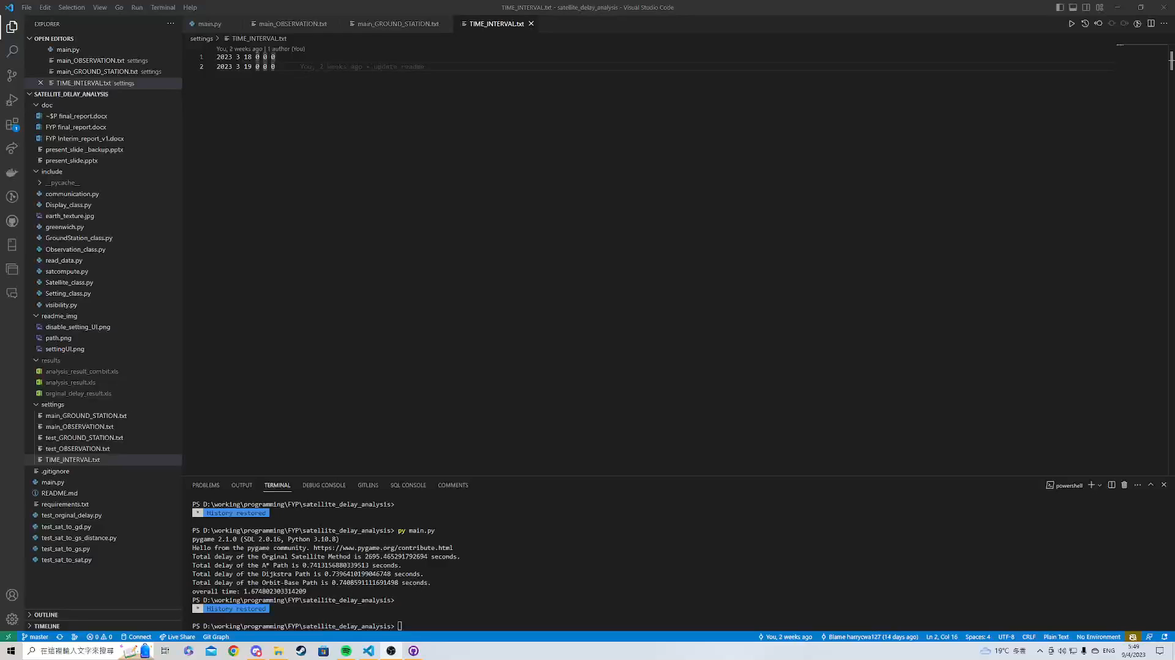

Slide 25
Thanks!
Any questions?
You can find me at 21032048d@connect.polyu.hk

